Slide 1
Virtual Memory

Slide 2
Background (Cont.)
Virtual memory – separation of user logical memory from physical memory
  Only part of the program needs to be in memory for execution
  Logical address space can therefore be much larger than physical address space
  Allows address spaces to be shared by several processes
  Allows for more efficient process creation
  More programs running concurrently
  Less I/O needed to load or swap processes

Slide 3

Virtual Memory That is Larger Than Physical Memory

Slide 4
Background (Cont.)
Virtual address space – logical view of how process is stored in memory
  Usually start at address 0, contiguous addresses until end of space
  Meanwhile, physical memory organized in page frames
  MMU must map logical to physical
Virtual memory can be implemented via:
  Demand paging
  Demand segmentation

Slide 5

Virtual-address Space
Usually design logical address space for stack to start at Max logical address and grow “down” while heap grows “up”
  Maximizes address space use
  Unused address space between the two is hole
    No physical memory needed until heap or stack grows to a given new page
Enables sparse address spaces with holes left for growth, dynamically linked libraries, etc
System libraries shared via mapping into virtual address space
Shared memory by mapping pages read-write into virtual address space
Pages can be shared during fork(), speeding process creation

Slide 6

Shared Library Using Virtual Memory

Slide 7

Demand Paging
Could bring entire process into memory at load time
Or bring a page into memory only when it is needed
  Less I/O needed, no unnecessary I/O
  Less memory needed
  Faster response
  More users
Similar to paging system with swapping (diagram on right)
Page is needed ⇒ reference to it
  invalid reference ⇒ abort
  not-in-memory ⇒ bring to memory
Lazy swapper – never swaps a page into memory unless page will be needed
  Swapper that deals with pages is a pager

Slide 8
Basic Concepts
With swapping, pager guesses which pages will be used before swapping out again
Instead, pager brings in only those pages into memory
How to determine that set of pages?
  Need new MMU functionality to implement demand paging
If pages needed are already memory resident
  No difference from non demand-paging
If page needed and not memory resident
  Need to detect and load the page into memory from storage
    Without changing program behavior
    Without programmer needing to change code

Slide 9

Valid-Invalid Bit
With each page table entry a valid–invalid bit is associated
(v ⇒ in-memory – memory resident, i ⇒ not-in-memory)
Initially valid–invalid bit is set to i on all entries
Example of a page table snapshot:
During MMU address translation, if valid–invalid bit in page table entry is i ⇒ page fault

Slide 10

Page Table When Some Pages Are Not in Main Memory

Slide 11
Page Fault
If there is a reference to a page, first reference to that page will trap to operating system:
page fault
Operating system looks at another table to decide:
  Invalid reference ⇒ abort
  Just not in memory
Find free frame
Swap page into frame via scheduled disk operation
Reset tables to indicate page now in memory
Set validation bit = v
Restart the instruction that caused the page fault

Slide 12

Steps in Handling a Page Fault

Slide 13
Aspects of Demand Paging
Extreme case – start process with no pages in memory
  OS sets instruction pointer to first instruction of process, non-memory-resident -> page fault
  And for every other process pages on first access
  Pure demand paging
Actually, a given instruction could access multiple pages -> multiple page faults
  Consider fetch and decode of instruction which adds 2 numbers from memory and stores result back to memory
  Pain decreased because of locality of reference
Hardware support needed for demand paging
  Page table with valid / invalid bit
  Secondary memory (swap device with swap space)
  Instruction restart

Slide 14

Instruction Restart
Consider an instruction that could access several different locations
  block move
  auto increment/decrement location
  Restart the whole operation?
    What if source and destination overlap?

Slide 15
Page Replacement
Prevent over-allocation of memory by modifying page-fault service routine to include page replacement
Use modify (dirty) bit to reduce overhead of page transfers – only modified pages are written to disk
Page replacement completes separation between logical memory and physical memory – large virtual memory can be provided on a smaller physical memory

Slide 16

Need For Page Replacement

Slide 17
Basic Page Replacement
Find the location of the desired page on disk
Find a free frame:
- If there is a free frame, use it
- If there is no free frame, use a page replacement algorithm to select a victim frame
- Write victim frame to disk if dirty
Bring the desired page into the (newly) free frame; update the page and frame tables
Continue the process by restarting the instruction that caused the trap
Note now potentially 2 page transfers for page fault – increasing EAT

Slide 18

Page Replacement

Slide 19
Page and Frame Replacement Algorithms
Frame-allocation algorithm determines
  How many frames to give each process
  Which frames to replace
Page-replacement algorithm
  How to select the victim frame.
  Want lowest page-fault rate on both first access and re-access
Evaluate algorithm by running it on a particular string of memory references (reference string) and computing the number of page faults on that string
  String is just page numbers, not full addresses
  Repeated access to the same page does not cause a page fault
  Results depend on number of frames available
In all our examples, the reference string of referenced page numbers is
7,0,1,2,0,3,0,4,2,3,0,3,0,3,2,1,2,0,1,7,0,1

Slide 20

Graph of Page Faults Versus The Number of Frames

Slide 21

First-In-First-Out (FIFO) Algorithm
Reference string: 7,0,1,2,0,3,0,4,2,3,0,3,0,3,2,1,2,0,1,7,0,1
3 frames (3 pages can be in memory at a time per process)
Can vary by reference string: consider 1,2,3,4,1,2,5,1,2,3,4,5
  Adding more frames can cause more page faults!
    Belady’s Anomaly
How to track ages of pages?
  Just use a FIFO queue
15 page faults

Slide 22

FIFO Illustrating Belady’s Anomaly

Slide 23

Optimal Algorithm
Replace page that will not be used for longest period of time
  9 is optimal for the example
How do you know this?
  Can’t read the future
Used for measuring how well your algorithm performs

Slide 24

Least Recently Used (LRU) Algorithm
Use past knowledge rather than future
Replace page that has not been used in the most amount of time
Associate time of last use with each page
12 faults – better than FIFO but worse than OPT
Generally good algorithm and frequently used
But how to implement?

Slide 25
LRU Algorithm (Cont.)
Counter implementation
  Every page entry has a counter; every time page is referenced through this entry, copy the clock into the counter
  When a page needs to be changed, look at the counters to find smallest value
    Search through table needed
Stack implementation
  Keep a stack of page numbers in a double link form:
  Page referenced:
    move it to the top
    requires 6 pointers to be changed
  But each update more expensive
  No search for replacement
LRU and OPT are cases of stack algorithms that don’t have Belady’s Anomaly

Slide 26
Applications and Page Replacement
All of these algorithms have OS guessing about future page access
Some applications have better knowledge – i.e. databases
Memory intensive applications can cause double buffering
  OS keeps copy of page in memory as I/O buffer
  Application keeps page in memory for its own work
Operating system can given direct access to the disk, getting out of the way of the applications
  Raw disk mode
Bypasses buffering, locking, etc

Slide 27
Disk Structure
Disk drives are addressed as large 1-dimensional arrays of logical blocks, where the logical block is the smallest unit of transfer
The 1-dimensional array of logical blocks is mapped into the sectors of the disk sequentially
  Sector 0 is the first sector of the first track on the outermost cylinder
  Mapping proceeds in order through that track, then the rest of the tracks in that cylinder, and then through the rest of the cylinders from outermost to innermost
  Logical to physical address should be easy
    Except for bad sectors
    Non-constant # of sectors per track via constant angular velocity

Slide 28
Disk Attachment
Host-attached storage accessed through I/O ports talking to I/O busses
SCSI itself is a bus, up to 16 devices on one cable, SCSI initiator requests operation and SCSI targets perform tasks
  Each target can have up to 8 logical units (disks attached to device controller)
FC is high-speed serial architecture
  Can be switched fabric with 24-bit address space – the basis of storage area networks (SANs) in which many hosts attach to many storage units
I/O directed to bus ID, device ID, logical unit (LUN)

Slide 29
Disk Scheduling
The operating system is responsible for using hardware efficiently — for the disk drives, this means having a fast access time and disk bandwidth
Minimize seek time
Seek time  seek distance
Disk bandwidth is the total number of bytes transferred, divided by the total time between the first request for service and the completion of the last transfer

Slide 30
Disk Scheduling (Cont.)
There are many sources of disk I/O request
  OS
  System processes
  Users processes
I/O request includes input or output mode, disk address, memory address, number of sectors to transfer
OS maintains queue of requests, per disk or device
Idle disk can immediately work on I/O request, busy disk means work must queue
  Optimization algorithms only make sense when a queue exists
Note that drive controllers have small buffers and can manage a queue of I/O requests (of varying “depth”)
Several algorithms exist to schedule the servicing of disk I/O requests
The analysis is true for one or many platters
We illustrate scheduling algorithms with a request queue (0-199)
98, 183, 37, 122, 14, 124, 65, 67
Head pointer 53

Slide 31
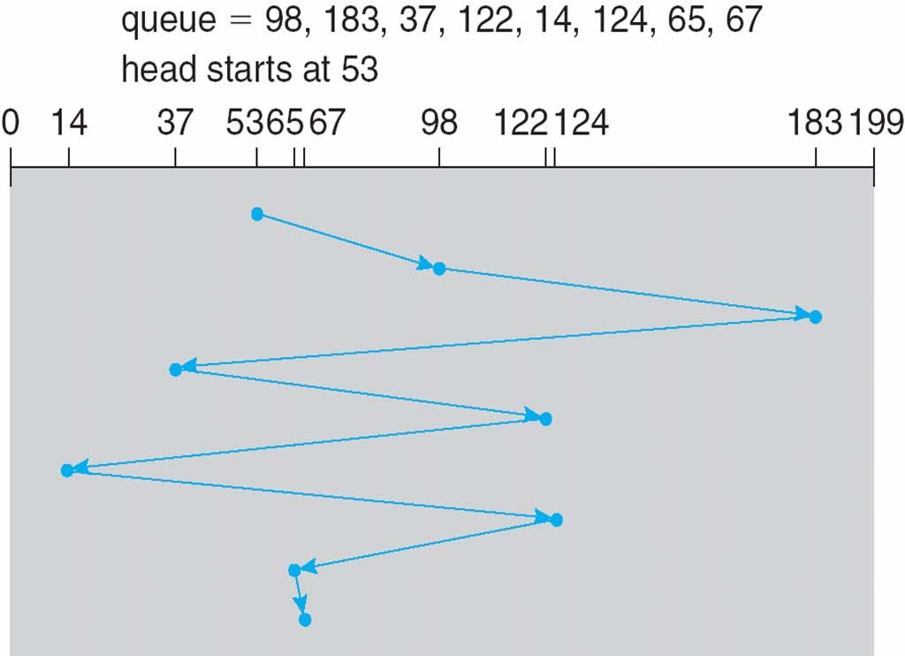
FCFS
Illustration shows total head movement of 640 cylinders

Slide 32
SSTF
Shortest Seek Time First selects the request with the minimum seek time from the current head position
SSTF scheduling is a form of SJF scheduling; may cause starvation of some requests
Illustration shows total head movement of 236 cylinders

Slide 33

SSTF (Cont.)

Slide 34
SCAN
The disk arm starts at one end of the disk, and moves toward the other end, servicing requests until it gets to the other end of the disk, where the head movement is reversed and servicing continues.
SCAN algorithm Sometimes called the elevator algorithm
Illustration shows total head movement of 208 cylinders
But note that if requests are uniformly dense, largest density at other end of disk and those wait the longest

Slide 35
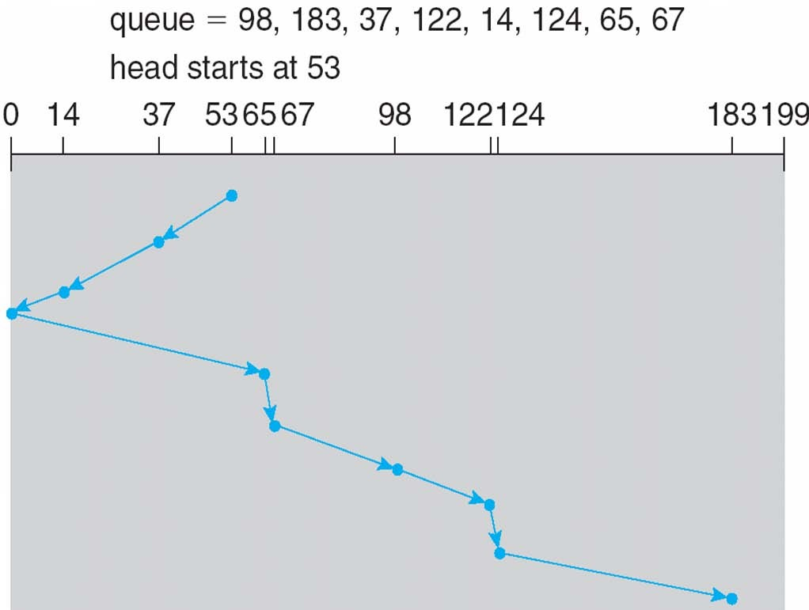
SCAN (Cont.)

Slide 36
C-SCAN
Provides a more uniform wait time than SCAN
The head moves from one end of the disk to the other, servicing requests as it goes
  When it reaches the other end, however, it immediately returns to the beginning of the disk, without servicing any requests on the return trip
Treats the cylinders as a circular list that wraps around from the last cylinder to the first one
Total number of cylinders?

Slide 37
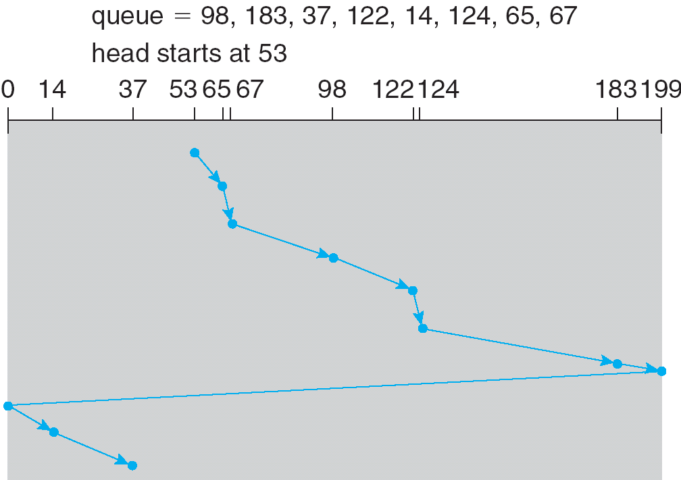
C-SCAN (Cont.)

Slide 38
C-LOOK
LOOK a version of SCAN, C-LOOK a version of C-SCAN
Arm only goes as far as the last request in each direction, then reverses direction immediately, without first going all the way to the end of the disk
Total number of cylinders?

Slide 39
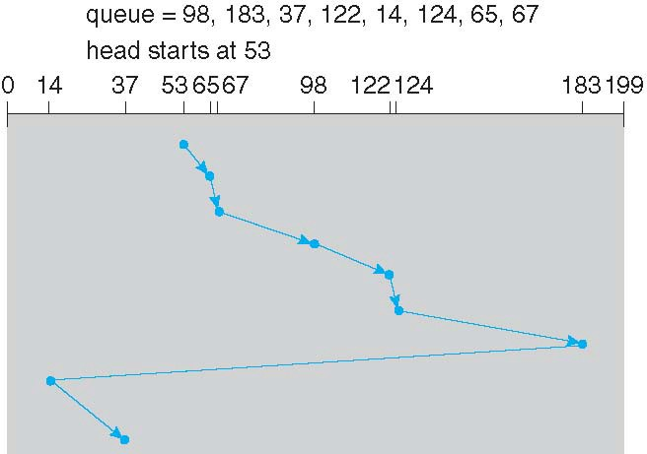
C-LOOK (Cont.)

Slide 40
Selecting a Disk-Scheduling Algorithm
SSTF is common and has a natural appeal
SCAN and C-SCAN perform better for systems that place a heavy load on the disk
  Less starvation
Performance depends on the number and types of requests
Requests for disk service can be influenced by the file-allocation method
  And metadata layout
The disk-scheduling algorithm should be written as a separate module of the operating system, allowing it to be replaced with a different algorithm if necessary
Either SSTF or LOOK is a reasonable choice for the default algorithm
What about rotational latency?
  Difficult for OS to calculate
How does disk-based queuing effect OS queue ordering efforts?

Slide 41
Disk Management
Low-level formatting, or physical formatting — Dividing a disk into sectors that the disk controller can read and write
  Each sector can hold header information, plus data, plus error correction code (ECC)
  Usually 512 bytes of data but can be selectable
To use a disk to hold files, the operating system still needs to record its own data structures on the disk
  Partition the disk into one or more groups of cylinders, each treated as a logical disk
  Logical formatting or “making a file system”
  To increase efficiency most file systems group blocks into clusters
    Disk I/O done in blocks
    File I/O done in clusters
Boot block initializes system
  The bootstrap is stored in ROM
  Bootstrap loader program stored in boot blocks of boot partition
Methods such as sector sparing used to handle bad blocks

Slide 42
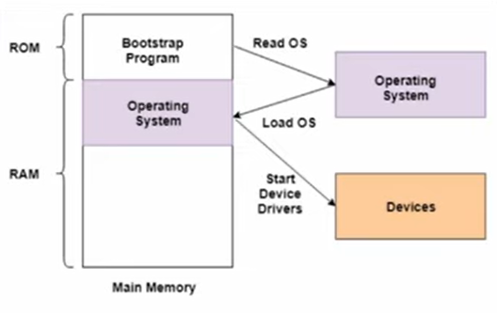

Slide 43

Booting from a Disk in Windows 2000

Slide 44
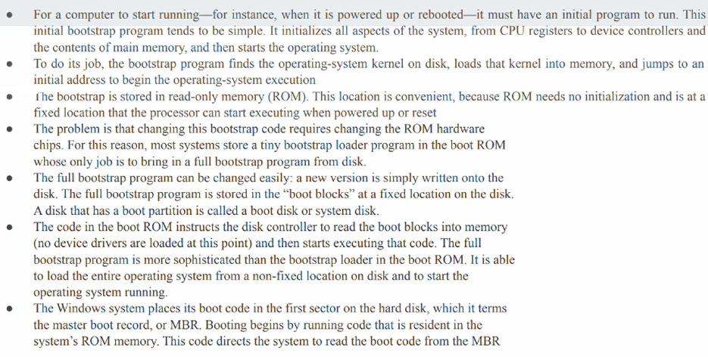

Slide 45
Reliability
A fixed disk drive is likely to be more reliable than a removable disk or tape drive
An optical cartridge is likely to be more reliable than a magnetic disk or tape
A head crash in a fixed hard disk generally destroys the data, whereas the failure of a tape drive or optical disk drive often leaves the data cartridge unharmed

Slide 46
RAID
RAID: Redundant Arrays of Independent Disks
  disk organization techniques that manage a large numbers of disks, providing a view of a single disk of
    high capacity and high speed by using multiple disks in parallel,
    high reliability by storing data redundantly, so that data can be recovered even if a disk fails
The chance that some disk out of a set of N disks will fail is much higher than the chance that a specific single disk will fail.
  E.g., a system with 100 disks, each with MTTF of 100,000 hours (approx. 11 years), will have a system MTTF of 1000 hours (approx. 41 days)
  Techniques for using redundancy to avoid data loss are critical with large numbers of disks
Originally a cost-effective alternative to large, expensive disks
  I in RAID originally stood for ``inexpensive’’
  Today RAIDs are used for their higher reliability and bandwidth.
    The “I” is interpreted as independent

Slide 47
Improvement of Reliability via Redundancy
Redundancy – store extra information that can be used to rebuild information lost in a disk failure
E.g., Mirroring (or shadowing)
  Duplicate every disk. Logical disk consists of two physical disks.
  Every write is carried out on both disks
    Reads can take place from either disk
  If one disk in a pair fails, data still available in the other
    Data loss would occur only if a disk fails, and its mirror disk also fails before the system is repaired
      Probability of combined event is very small
        Except for dependent failure modes such as fire or building collapse or electrical power surges
Mean time to data loss depends on mean time to failure,
and mean time to repair
  E.g. MTTF of 100,000 hours, mean time to repair of 10 hours gives mean time to data loss of 500*10⁶ hours (or 57,000 years) for a mirrored pair of disks (ignoring dependent failure modes)

Slide 48
Improvement in Performance via Parallelism
Two main goals of parallelism in a disk system:
  1. Load balance multiple small accesses to increase throughput
  2. Parallelize large accesses to reduce response time.
Improve transfer rate by striping data across multiple disks.
Bit-level striping – split the bits of each byte across multiple disks
  In an array of eight disks, write bit i of each byte to disk i.
  Each access can read data at eight times the rate of a single disk.
  But seek/access time worse than for a single disk
    Bit level striping is not used much any more
Block-level striping – with n disks, block i of a file goes to disk (i mod n) + 1
  Requests for different blocks can run in parallel if the blocks reside on different disks
  A request for a long sequence of blocks can utilize all disks in parallel

Slide 49

RAID Levels
Schemes to provide redundancy at lower cost by using disk striping combined with parity bits
  Different RAID organizations, or RAID levels, have differing cost, performance and reliability characteristics
RAID Level 0: Block striping; non-redundant.
  Used in high-performance applications where data loss is not critical.
RAID Level 1: Mirrored disks with block striping
  Offers best write performance.
  Popular for applications such as storing log files in a database system.

Slide 50
RAID Levels (Cont.)
RAID Level 2: Memory-Style Error-Correcting-Codes (ECC) with bit striping.
RAID Level 3: Bit-Interleaved Parity
  a single parity bit is enough for error correction, not just detection, since we know which disk has failed
    When writing data, corresponding parity bits must also be computed and written to a parity bit disk
    To recover data in a damaged disk, compute XOR of bits from other disks (including parity bit disk)

Slide 51
RAID Levels (Cont.)
RAID Level 3 (Cont.)
  Faster data transfer than with a single disk, but fewer I/Os per second since every disk has to participate in every I/O.
  Subsumes Level 2 (provides all its benefits, at lower cost).
RAID Level 4: Block-Interleaved Parity; uses block-level striping, and keeps a parity block on a separate disk for corresponding blocks from N other disks.
  When writing data block, corresponding block of parity bits must also be computed and written to parity disk
  To find value of a damaged block, compute XOR of bits from corresponding blocks (including parity block) from other disks.

Slide 52
RAID Levels (Cont.)
RAID Level 4 (Cont.)
  Provides higher I/O rates for independent block reads than Level 3
    block read goes to a single disk, so blocks stored on different disks can be read in parallel
  Provides high transfer rates for reads of multiple blocks than no-striping
  Before writing a block, parity data must be computed
    Can be done by using old parity block, old value of current block and new value of current block (2 block reads + 2 block writes)
    Or by recomputing the parity value using the new values of blocks corresponding to the parity block
      More efficient for writing large amounts of data sequentially
  Parity block becomes a bottleneck for independent block writes since every block write also writes to parity disk

Slide 53

RAID Levels (Cont.)
RAID Level 5: Block-Interleaved Distributed Parity; partitions data and parity among all N + 1 disks, rather than storing data in N disks and parity in 1 disk.
  E.g., with 5 disks, parity block for nth set of blocks is stored on disk (n mod 5) + 1, with the data blocks stored on the other 4 disks.

Slide 54
RAID Levels (Cont.)
RAID Level 5 (Cont.)
  Higher I/O rates than Level 4.
    Block writes occur in parallel if the blocks and their parity blocks are on different disks.
  Subsumes Level 4: provides same benefits, but avoids bottleneck of parity disk.
RAID Level 6: P+Q Redundancy scheme; similar to Level 5, but stores extra redundant information to guard against multiple disk failures.
  Better reliability than Level 5 at a higher cost; not used as widely.

Slide 55
Choice of RAID Level
Factors in choosing RAID level
  Monetary cost
  Performance: Number of I/O operations per second, and bandwidth during normal operation
  Performance during failure
  Performance during rebuild of failed disk
    Including time taken to rebuild failed disk
RAID 0 is used only when data safety is not important
  E.g. data can be recovered quickly from other sources
Level 2 and 4 never used since they are subsumed by 3 and 5
Level 3 is not used anymore since bit-striping forces single block reads to access all disks, wasting disk arm movement, which block striping (level 5) avoids
Level 6 is rarely used since levels 1 and 5 offer adequate safety for most applications

Slide 56
Choice of RAID Level (Cont.)
Level 1 provides much better write performance than level 5
  Level 5 requires at least 2 block reads and 2 block writes to write a single block, whereas Level 1 only requires 2 block writes
  Level 1 preferred for high update environments such as log disks
Level 1 had higher storage cost than level 5
  disk drive capacities increasing rapidly (50%/year) whereas disk access times have decreased much less (x 3 in 10 years)
  I/O requirements have increased greatly, e.g. for Web servers
  When enough disks have been bought to satisfy required rate of I/O, they often have spare storage capacity
    so there is often no extra monetary cost for Level 1!
Level 5 is preferred for applications with low update rate,
and large amounts of data
Level 1 is preferred for all other applications

Slide 57
End of Chapter

